Slide 1
Performance Test Using Jmeter – Part 1

Slide 2

Contents
JMeter -Introduction
Installation And Configuration
Invocation
Enhancing Test Plan
Thread Group
Controller
Samplers
Logic Controller
Timers
Pre-Processors
Post-Processors
Assertions
Listeners

Slide 3
JMeter -Introduction
JMeter is a robust open source tool available for performance testing of different applications, servers, protocol types.
Web - HTTP, HTTPS, SOAP, Database via JDBC, LDAP, JMS, Mail - POP3, etc.
Easy to create Test plan, Execution and analysis
Using different samplers allow unrestricted testing capabilities
Easy integration with 3rd party tools like Bamboo, Jenkins, Maven, Splunk, Graddle

Slide 4
Installation And Configuration
JMeter is a Java application, so a JRE or SDK first needs to be installed with a JAVA_HOME environment variable.
Java 1.4 or higher version should be installed as pre requisite
JMeter can be downloaded in the below link:
http://jmeter.apache.org/download_jmeter.cgi
Download JMeter, and install by unzipping to the C:\ root folder

Slide 5
Invocation
Start JMeter from the bin folder (D:\apache-jmeter-3.2\bin) by selecting either Executable Jar File or Windows Batch File
If the site to be tested is behind a Proxy, add:
JMeter -H my.proxy.server -P 8000 -u username -a password –N localhost
Proxy Settings can also be defined in a Test Plan, using either the HTTP Request Defaults configuration or the HTTP Request sampler elements.

Slide 6
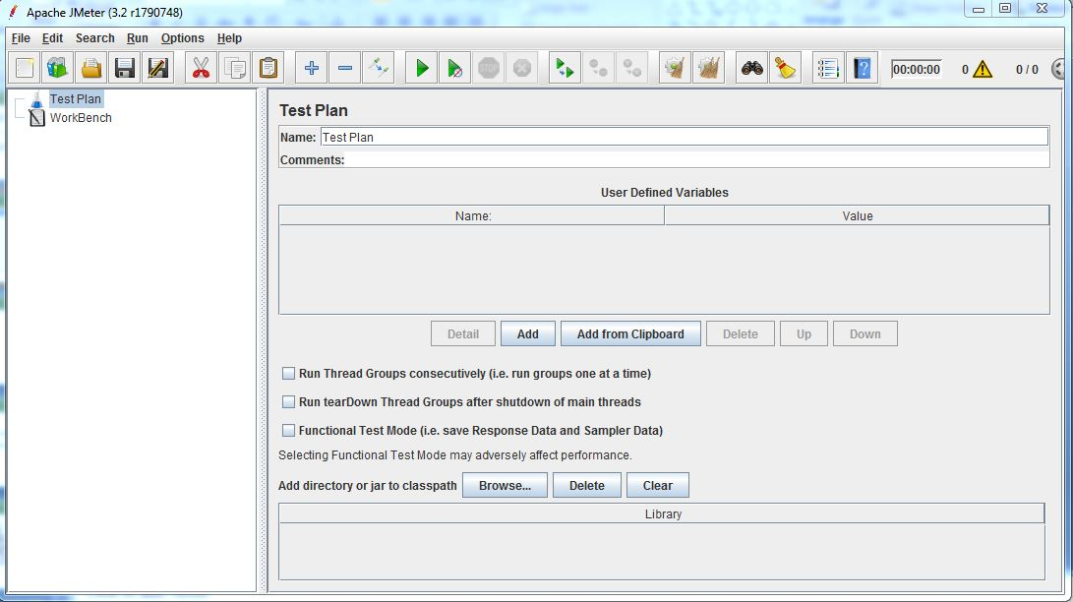
Enhancing Test Plan
To start JMeter, one need to have a test plan first which will help the JMeter to perform the testing in steps. There are several elements in a test plan like thread groups, listeners, assertions, sample generating controllers, logic controllers etc.
A test plan must have at least one thread group having all other JMeter elements which is the starting point of a test plan. Scenario settings should be done in thread group

Slide 7
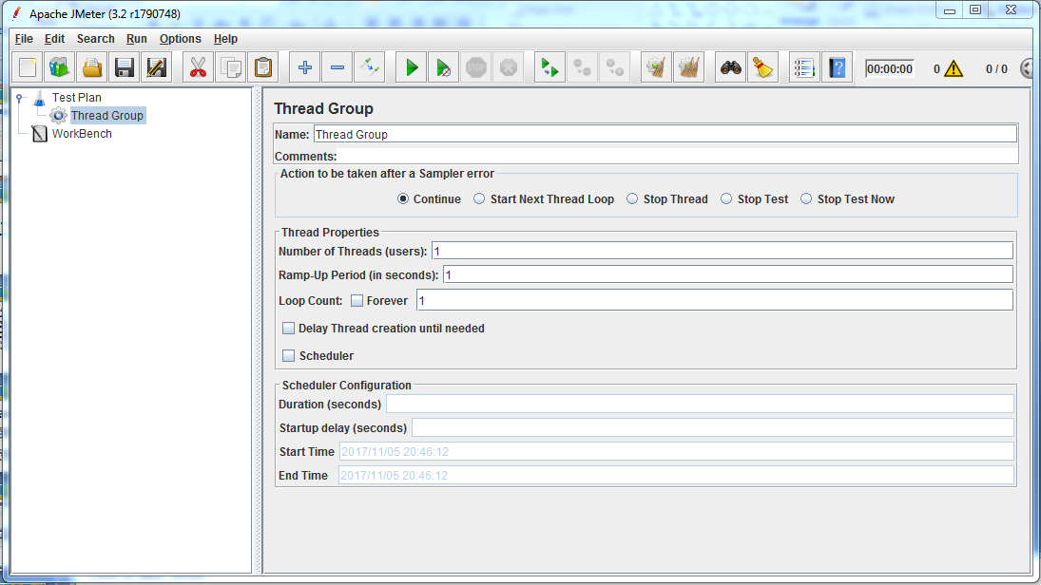
Thread Group
Test Plan->Thread Group
On the Thread Group you specify how many users you want to simulate, how fast they’re loaded and how many times you want to repeat the test plan.

Slide 8
Controller
JMeter has two types of Controllers
Samplers : Samplers tell JMeter to send requests to a server.
Logical Controllers : Logical Controllers let you customize the logic that JMeter uses to decide when to send requests.
These drive the processing of a test.

Slide 9
Samplers
Samplers tell JMeter to send requests to a server and wait for a response. They are processed in the order they appear in the tree.
JMeter samplers include:
FTP Request
HTTP Request
JDBC Request
Java object request
LDAP Request
SOAP/XML-RPC Request
WebService (SOAP) Request
Mail request
OS Process request
TCP request

Slide 10
Samplers
HTTP Request
HTTP Request
This sampler lets you send an HTTP/HTTPS request to a web server. It also lets you control whether or not JMeter parses HTML files for images and other embedded resources and sends HTTP requests to retrieve them. The following types of embedded resource are retrieved:
images
applets
stylesheets
external scripts
frames
background images (body, table, TD, TR)
background sound
The default parser is htmlparser. This can be changed by using the property "htmlparser.classname" - see jmeter.properties for details.
If you are going to send multiple requests to the same web server, consider using an HTTP Request Defaults Configuration Element so you do not have to enter the same information for each HTTP Request.
Or, instead of manually adding HTTP Requests, you may want to use JMeter's HTTP(S) Test Script Recorderto create them. This can save you time if you have a lot of HTTP requests or requests with many parameters.

Slide 11
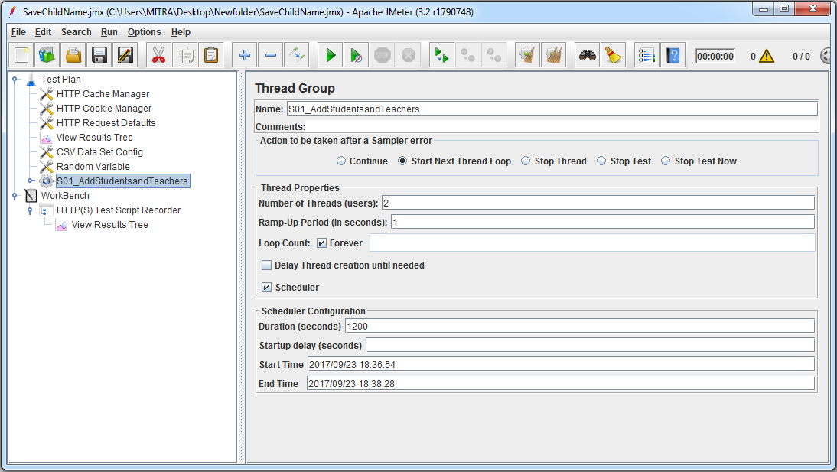
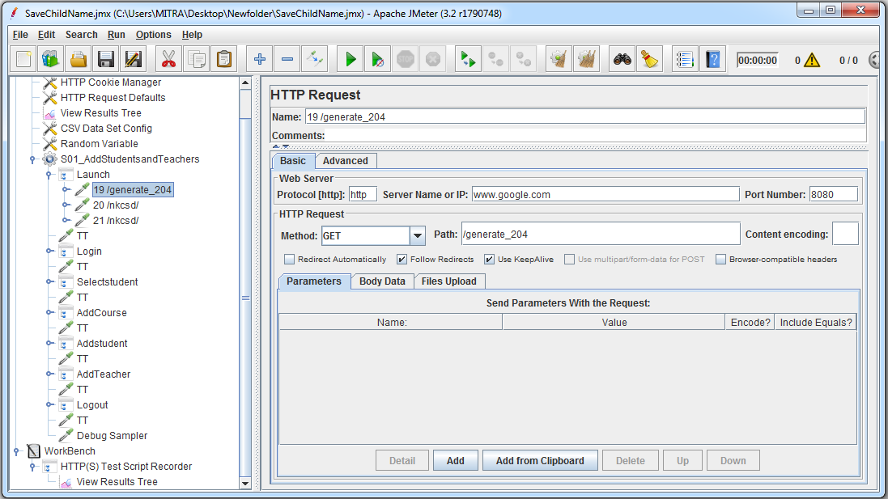
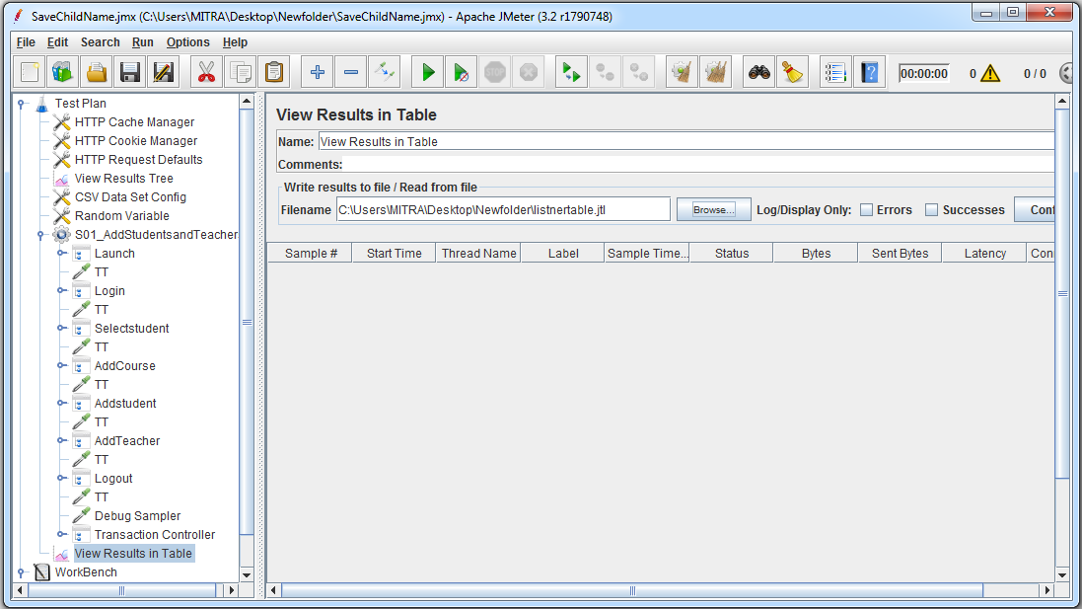
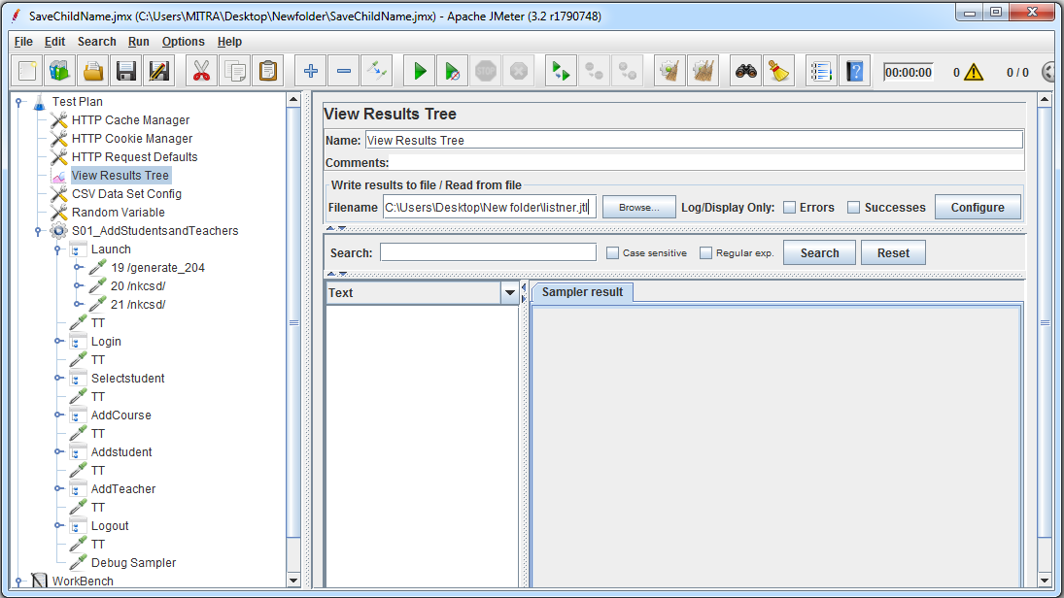
HTTP Request
Demo
Set the runtime options through thread group
In the HTTP request verify the server name and port number
Add view Results in table listener
Add view result tree listener

Slide 12
Logic Controller
Logic Controllers let you customize the logic that JMeter uses to decide when to send requests.
If controller
The If Controller allows the user to control whether the test elements below it (its children) are run or not.

Slide 13
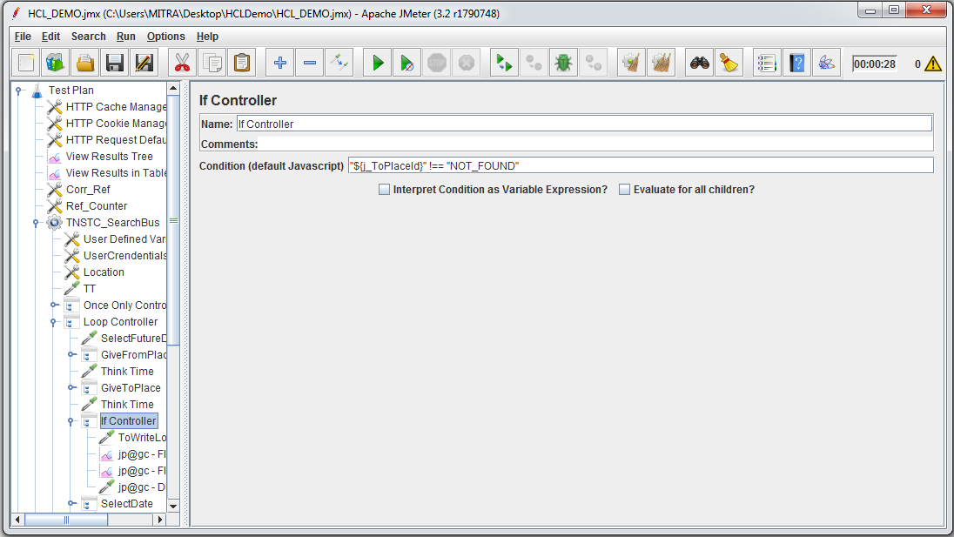
Logic Controller
IF – Controller Demo
Set the condition for the if controller

Slide 14
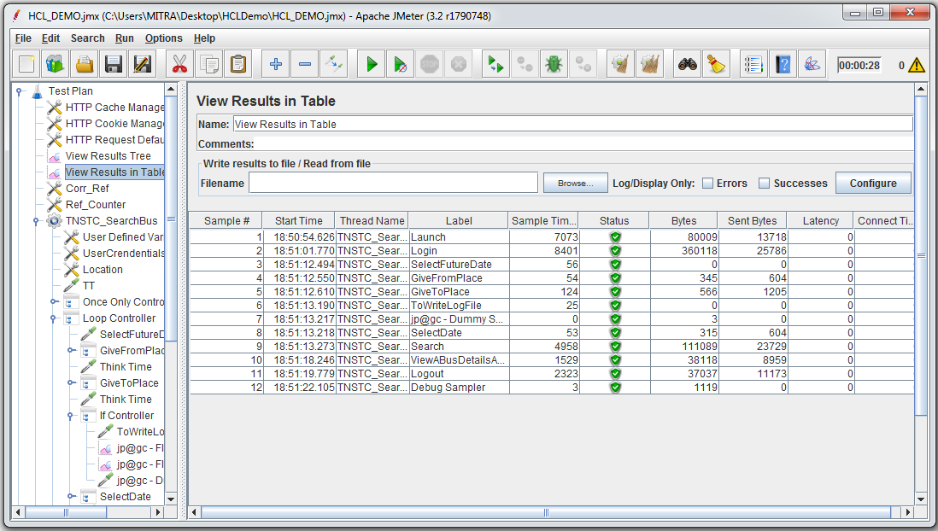
Logic Controller
IF – Controller Demo
Add the view results in table listener

Slide 15
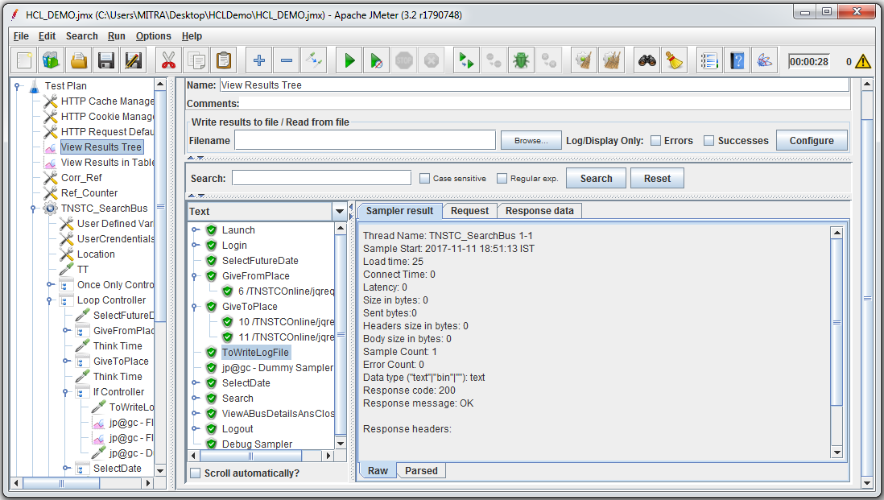
Logic Controller
IF – Controller Demo
Add the view results tree listener & Run the test

Slide 16
Logic Controller
Loop– Controller
Loop Controller
If you add Generative or Logic Controllers to a Loop Controller, JMeter will loop through them a certain number of times, in addition to the loop value you specified for the Thread Group. For example, if you add one HTTP Request to a Loop Controller with a loop count of two, and configure the Thread Group loop count to three, JMeter will send a total of 2 * 3 = 6 HTTP Request

Slide 17
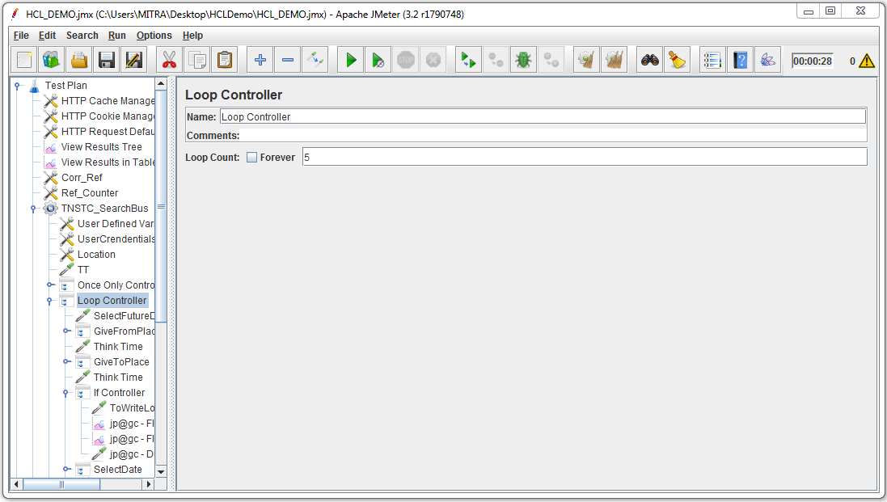
Logic Controller
Loop – Controller Demo
Enter the loop count

Slide 18
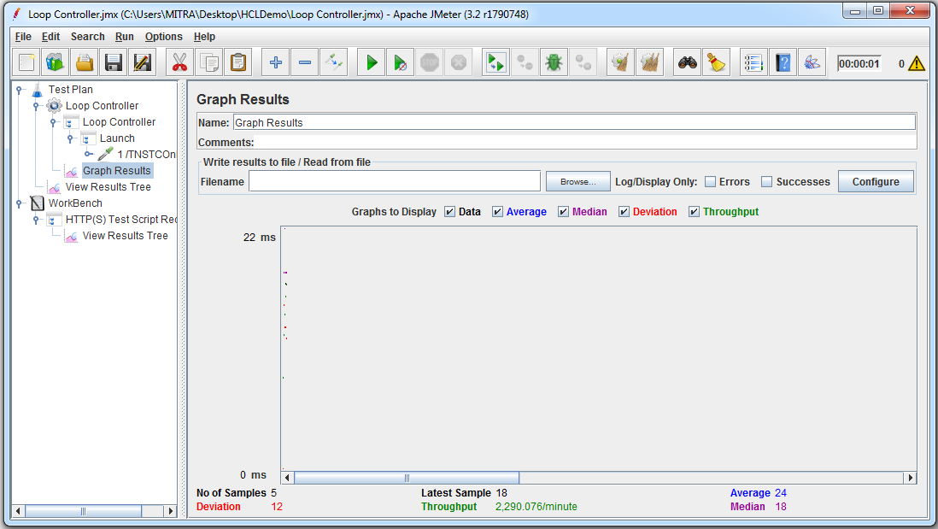
Logic Controller
Loop – Controller Demo
Add the file reporter

Slide 19
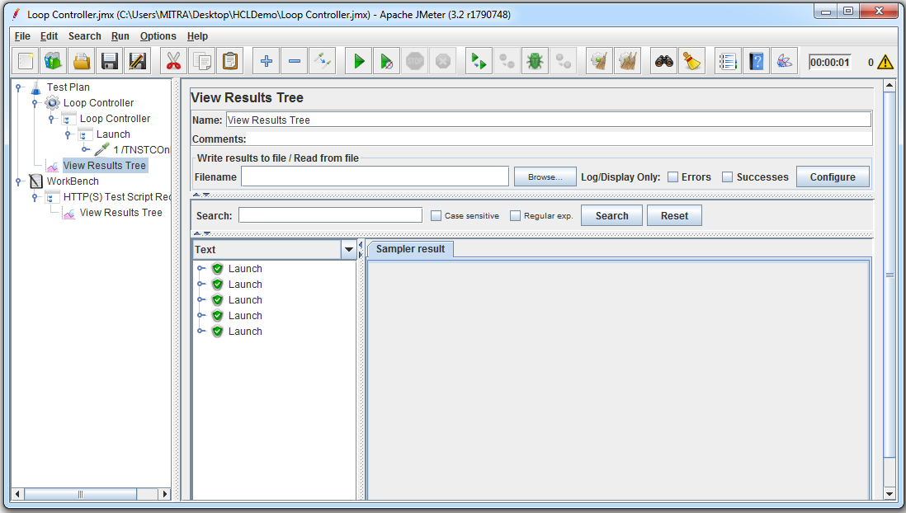
Logic Controller
Loop – Controller Demo
Add the View results tree listener

Slide 20
Timers
The timer will cause JMeter to delay a certain amount of time before each request that a thread makes.
Timers are processed before each sampler in the scope in which they are found; if there are several timers in the same scope, all the timers will be processed before each sampler. Timers are only processed in conjunction with a sampler. A timer which is not in the same scope as a sampler will not be processed at all.
To apply a timer to a single sampler, add the timer as a child element of the sampler. The timer will be applied before the sampler is executed. To apply a timer after a sampler, either add it to the next sampler, or add it as the child of a Test Action Sampler.

Slide 21
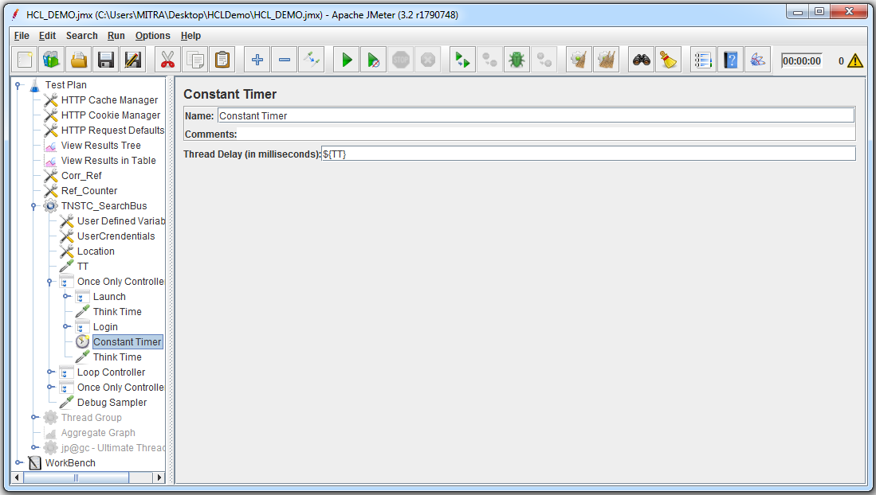
Timers
Constant Timer:
If you want to have each thread pause for the same amount of time between requests, use this timer

Slide 22
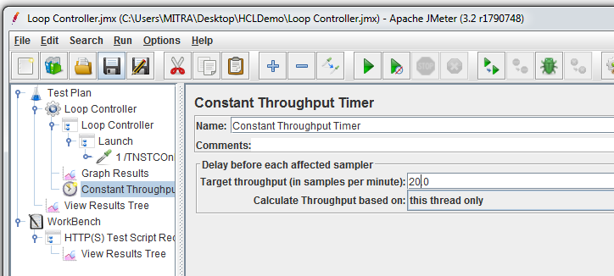
Timers
Constant Throughput Timer:
This timer introduces variable pauses, calculated to keep the total throughput (in terms of samples per minute) as close as possible to a give figure. Of course the throughput will be lower if the server is not capable of handling it, or if other timers or time-consuming test elements prevent it.

Slide 23
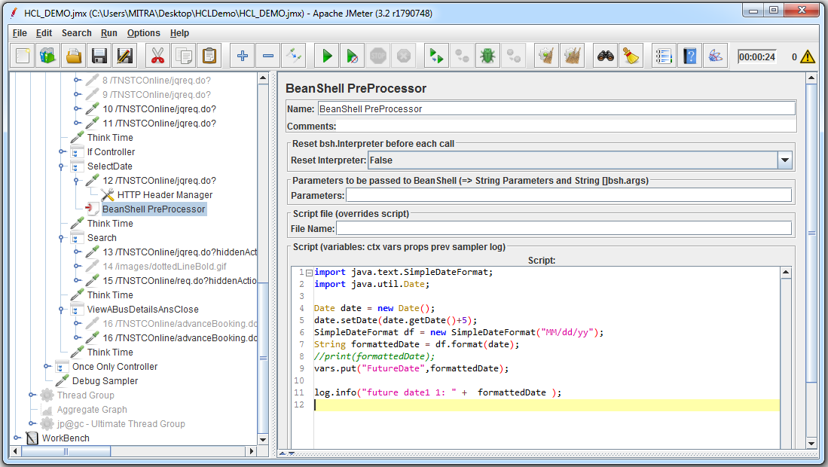
Pre-Processors
A Pre-Processor executes some action prior to a Sampler Request being made. If a Pre-Processor is attached to a Sampler element, then it will execute just prior to that sampler element running
Pre-processors are used to modify the Samplers in their scope.

Slide 24
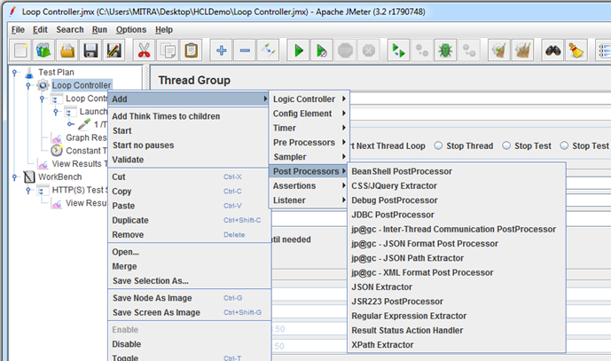
Post-Processors
Post-Processors are applied after samplers. Note that they are applied to all the samplers in the same scope, so to ensure that a post-processor is applied only to a particular sampler, add it as a child of the sampler.
Post-Processors are run before Assertions, so they do not have access to any Assertion Results, nor will the sample status reflect the results of any Assertions. If you require access to Assertion Results, try using a Listener instead

Slide 25
Assertions
Assertions are used to perform additional checks on samplers, and are processed after every sampler in the same scope. To ensure that an Assertion is applied only to a particular sampler, add it as a child of the sampler.
Assertions can be applied to either the main sample, the sub-samples or both. The default is to apply the assertion to the main sample only.

Slide 26
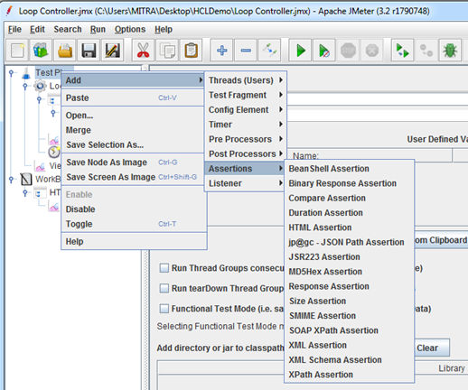
Assertions
Sample Demo
Assertions are not applied to sub-samples (child samples) - only to the parent sample. In the case of JSR223 and BeanShell Assertions, the script can retrieve sub-samples using the method prev.getSubResults() which returns an array of Sample Results. The array will be empty if there are none.

Slide 27
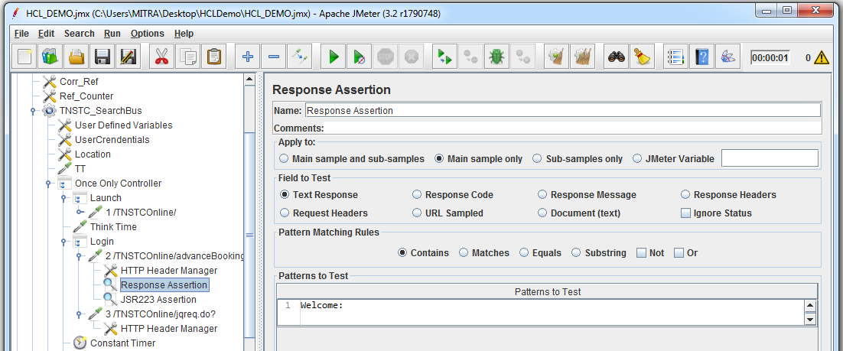
Assertions
Sample Demo
The response assertion control panel lets you add pattern strings to be compared against various fields of the request or response. The pattern strings are:
Contains, Matches: Perl5-style regular expression
Equals, Substring: plain text, case-sensitive

Slide 28
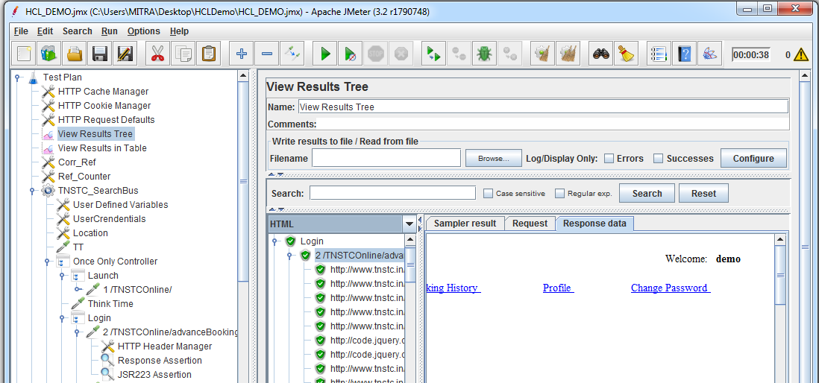
Assertions
Sample Demo
Select the view results tree listener

Slide 29
Listeners
Most of the listeners perform several roles in addition to "listening" to the test results. They also provide means to view, save, and read saved test results. Listeners are processed at the end of the scope in which they are found.
The saving and reading of test results is generic. The various listeners have a panel whereby one can specify the file to which the results will be written (or read from). By default, the results are stored as XML files, typically with a ".jtl" extension. Storing as CSV is the most efficient option, but is less detailed than XML (the other available option).

Slide 30
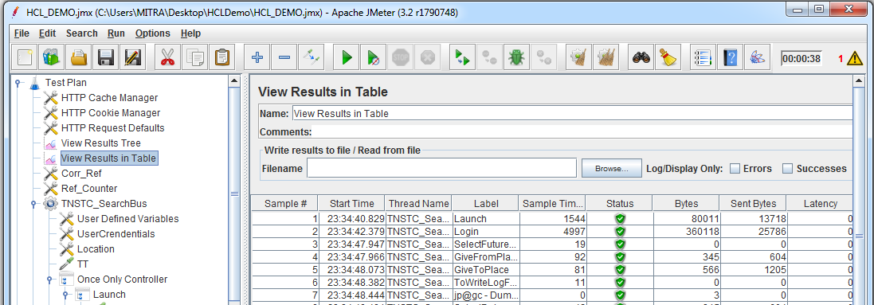
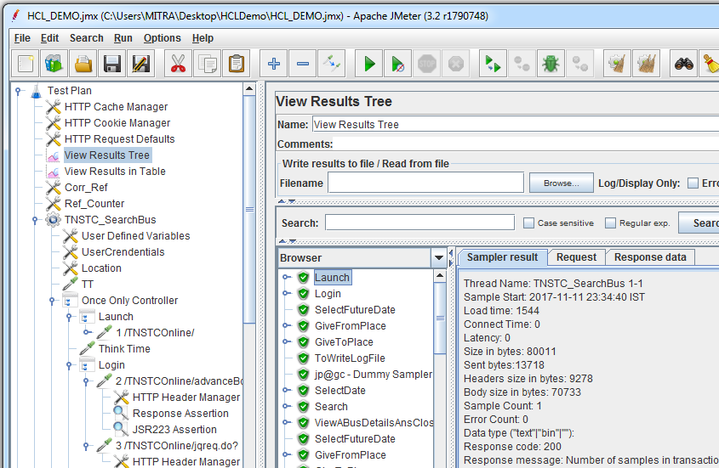
Listeners
Most commonly used listeners are view results tee and view results in table

